Slide 1
PRINCIPAL’S REPORT

Slide 2
TOPICS
Current Vacancies/New Hires
Attendance Data
Family Engagement

Slide 3
CURRENT VACANCIES

Slide 4
Non-Instructional Para
and
SPED Para

Slide 5
NEW HIRES

Slide 6
2ND GRADE TEACHER Filled by
Arrice Spicer
Notes:
We currently have 1 vacancy as of September 16th. Teacher took a social worker position in Fulton County. We have interviewed 2 candidates and will have another later this week. We anticipate filling the vacancy with one of the candidates.

Slide 7
1-on-1 SPED
Filled by
Ms. Marley Baugh
Notes:
We currently have 1 vacancy as of September 16th. Teacher took a social worker position in Fulton County. We have interviewed 2 candidates and will have another later this week. We anticipate filling the vacancy with one of the candidates.

Slide 8
ATTENDANCE

Slide 9
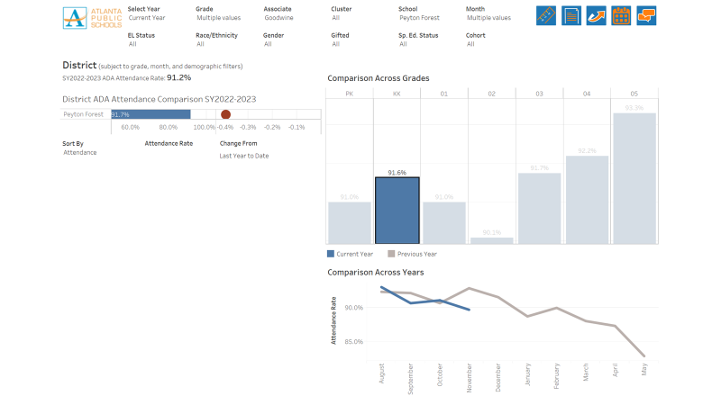
ATTENDANCE

Slide 10
FAMILY ENGAGEMENT

Slide 11

SEPTEMBER
Breakfast Club
    Parents of students with attendance/academic concerns
Individual Parent Conferences (virtually and in-person_
    MAP Scores
    Attendance
    Current Grades

Slide 12
OCTOBER
Title I/Curriculum Night
    Overview of Title I components
    Parents received literacy and numeracy resources to practice at home (sight words/flash cards)
Grandparent’s Day/Bookfair

Slide 13
NOVEMBER
Thanksgiving Lunch
    November 16th
    Volunteers Needed

Slide 14
QUESTIONS?

Slide 15


Where we’re going
Before we leave for Winter Break, we will take Action (vote) on ranking our strategic priorities for the 2023-2024 school year.
Let me or the Chair know of any additional information you need for our future discussion.

Slide 16
Thank you

